Slide 1
The iMagine AI platform for image analysis - Opportunities for aquatic sciences
Gergely Sipos (EGI Foundation) On behalf of the iMagine consortium
EGI 2023 Conference
21/June/23, Poznan

Slide 2
Outline
Project facts
Technical architecture
Imaging services and applications
Lessons learned
Opportunity to work with iMagine

Slide 3
50% of the global oxygen production is produced by photosynthesis of marine algae.
Oceans are home to the world’s largest diversity of species and habitats.
Annually 100 Mio tons of marine organisms are exploited as food source.

Slide 5
Project factsheet
OBJECTIVE:
To deploy, operate, validate, and promote a dedicated iMagine AI framework and platform, connected to EOSC and AI4EU, giving researchers in aquatic sciences open access to a diverse portfolio of AI based image analysis services and image repositories from multiple RIs, working on and of relevance to the overarching theme of ‘Healthy oceans, seas, coastal and inland waters’.
36 months
From Sept. 2022 until Aug. 2025
€4.5 million EC funding
23 participants (19 beneficiaries + 4 affiliated partners)
18 service installations (Virtual Access)

Slide 6
Enabling scalable AI/ML services
4 national cloud compute centres and 5 AI/ML technology development institutes supports
14 research institutes for 12 RIs
Notes:
Research institutes with Logo
AI/ML technical experts: LIP, CSIC, IISAS, KIT, UPV
Infrastructure providers: TUBITAK, CSIC, INCD, Walton, GRNET
EGI.eu
—--------------
Add consortium member logos, classify into these groups - Section 3.2 gives you the list
From DoA:
“The three groups will compose a single, integrated value-chain for marine and freshwater research:
● 4 Compute/data centres deliver generic compute-storage capabilities and related expertise for image analysis.
● 5 Technology development institutes provide AI/ML application development and deployment services, related user support and training. They use the generic compute-storage capabilities for scalable model training and delivery.
● 14 RI institutes benefit from these services, deploy and deliver thematic research datasets and applications on top for end users in research, policy-making and other related sectors.
”

Slide 7
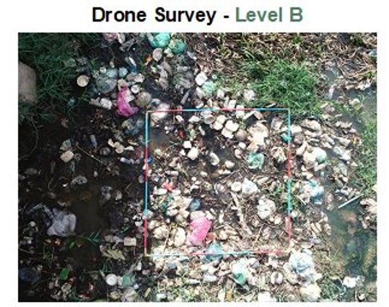
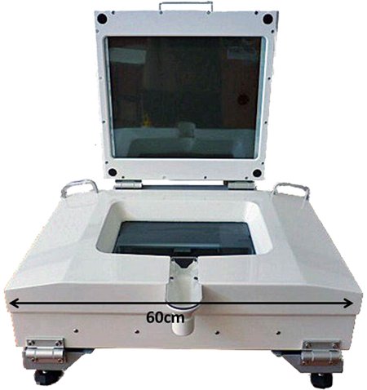
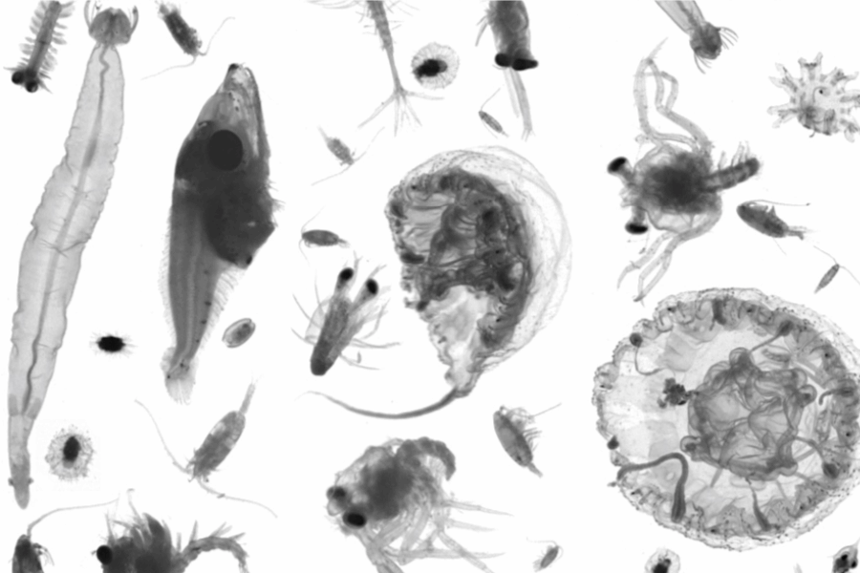
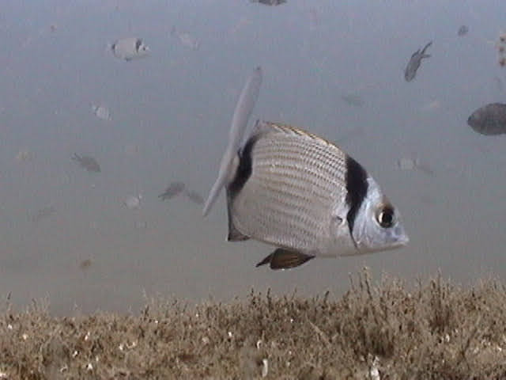
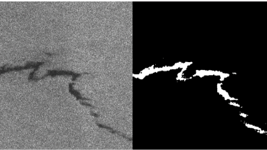
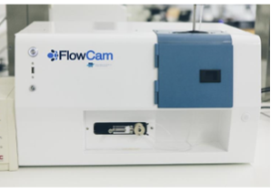
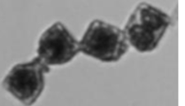
5 mature use cases
Aquatic Litter Drones: Aquatic Litter monitoring system using drones | DFKI (DE) + MARIS (NL) + OGS (IT)
EcoTaxa pipeline: Taxonomic identification of zooplankton using Zooscan | Sorbonne Université (LOV+IMEV) (FR)
Ecosystem monitoring at EMSO sites by video imagery | EMSO ERIC (IT) + UPC (ES) + Ifremer (FR) + MI (IE)
Oil Spill Detection: Oil spill detection from satellite images | CMCC (IT) + OrbitalEOS (ES) + Uni. of Trento (IT)
Taxonomic identification of phytoplankton using Flowcam images | VLIZ (BE)
60% oxygen on Earth!

Slide 8
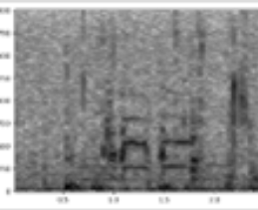
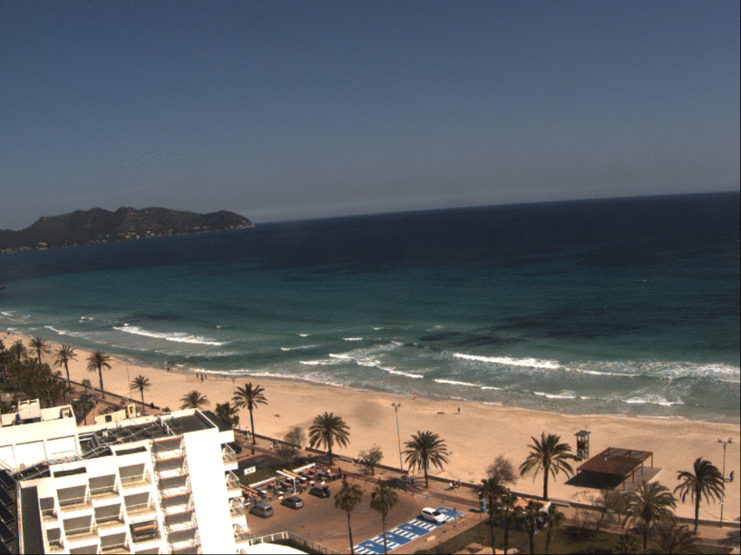
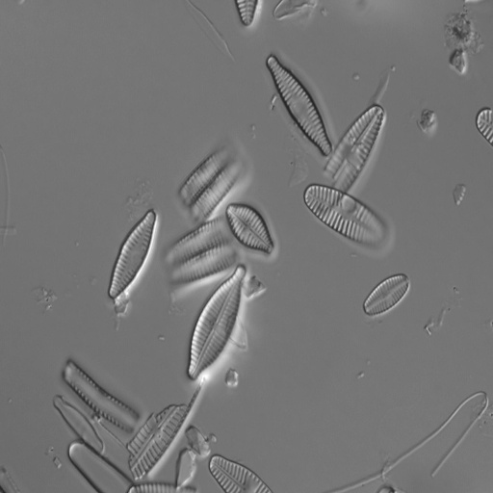
3 prototype use cases
Underwater Noise Identification: Underwater noise identification from acoustic recordings using spectrograms | VLIZ (BE)
Beach Monitoring: Posidonia oceanica berms and rip-currents detection from beach monitoring systems | SOCIB (ES)
Identification of diatoms in freshwater (unicellular microorganism) | UL-LIEC (FR) + CNRS-IRL2958 (FR) + SU-LOCEAN (FR)
Spectrograms
Palma

Slide 9
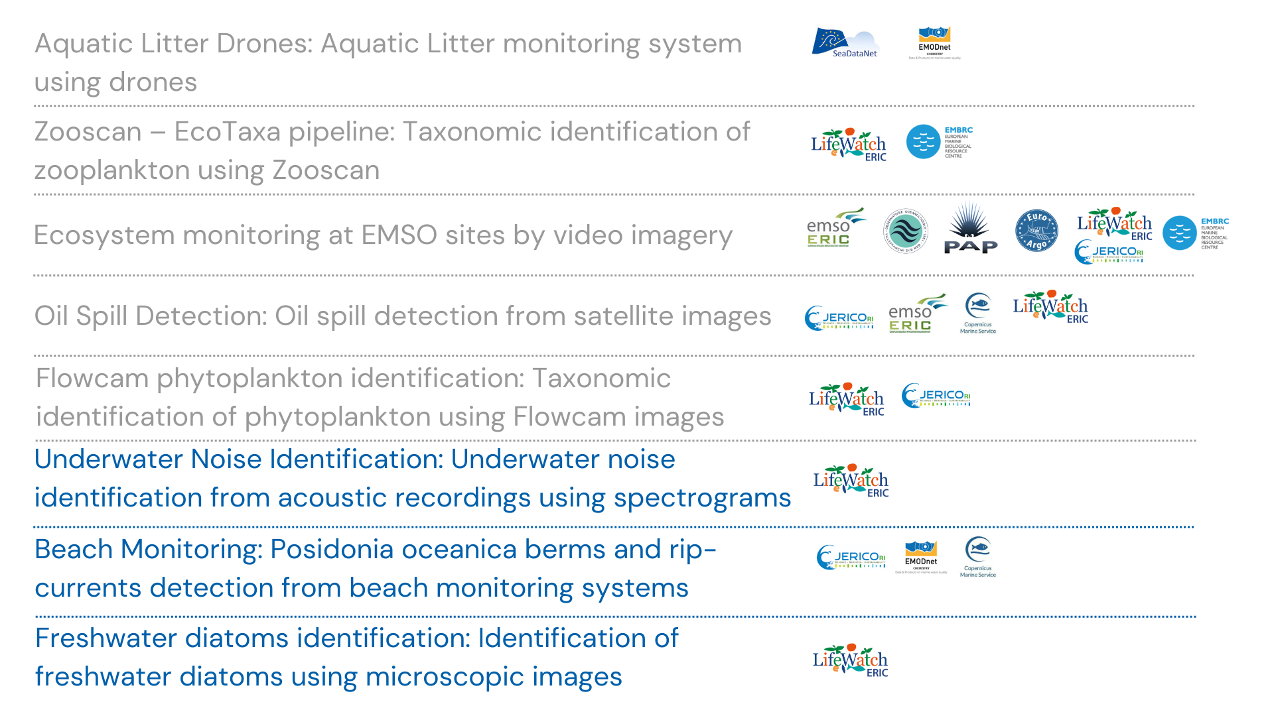
8 Use Cases & Their Links to RIs and Initiatives
Services with Virtual Access
Validated application prototypes

Slide 10
Specific Objectives and indicators
O1
Objective 1. Deliver a scalable, shared IT platform for image analysis in marine and freshwater research
Operational iMagine platform with common AI development framework
O2
Objective 2. Advance existing image analytical services to increase research performance in aquatic sciences
Launch of 5 aquatic AI image analytics services, running operationally on the iMagine platform
O3
Objective 3. Develop & prototype new image analytical services and datasets that can accelerate progress towards healthy oceans, seas, coastal and inland waters
3 AI-based imaging processing application pilots, 8 scientific image repositories
O4
Objective 4. Capture and disseminate development and operational best practices to imaging data and image analysis service providers
Best Practices documentation, interaction with EOSC and AI4EU platforms. + Training programme
O5
Objective 5. Deliver a portfolio of scientific image and image analytics services targeting researchers in marine and aquatic sciences
Portfolio: operational services, image repositories, Best Practices, iMagine framework and platform

Slide 11
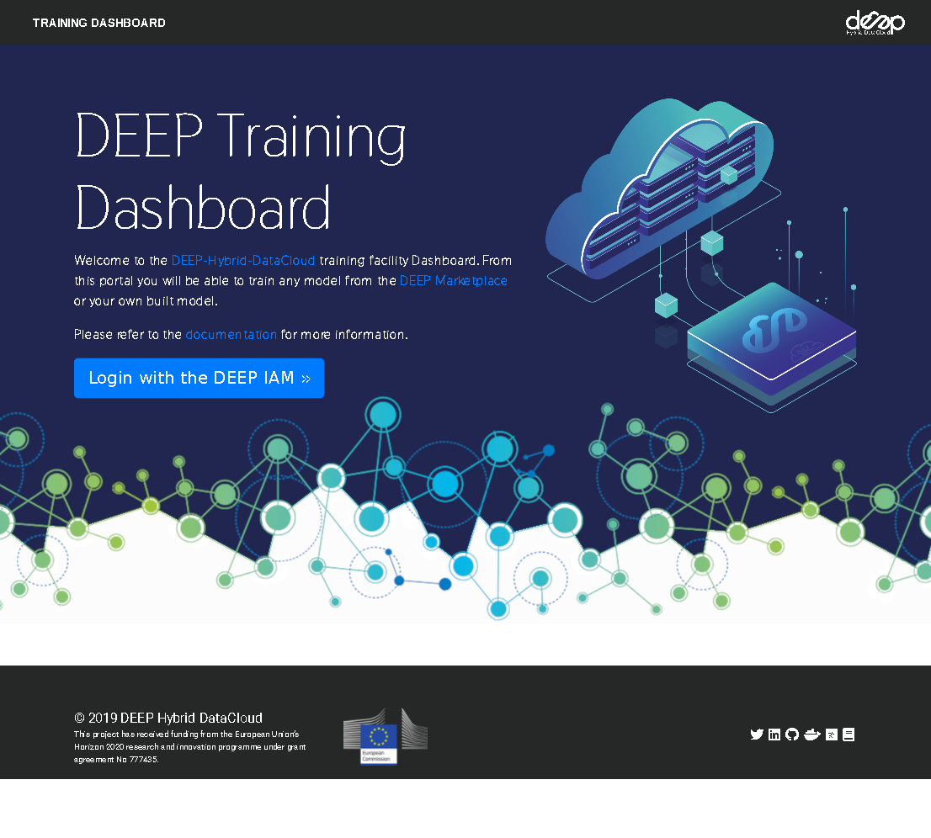
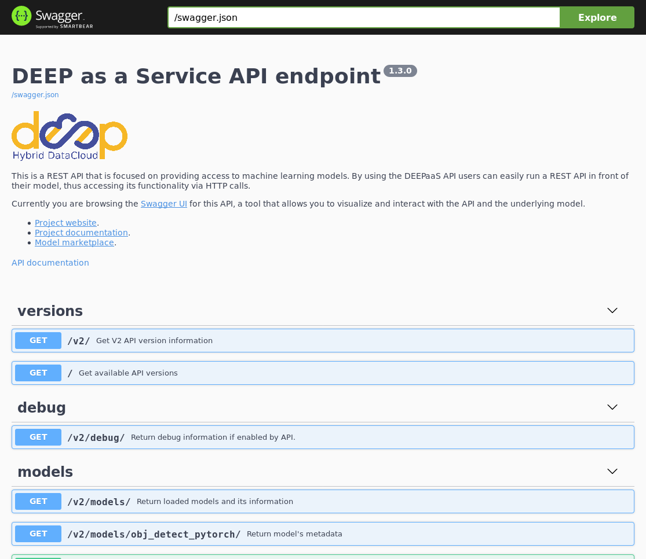
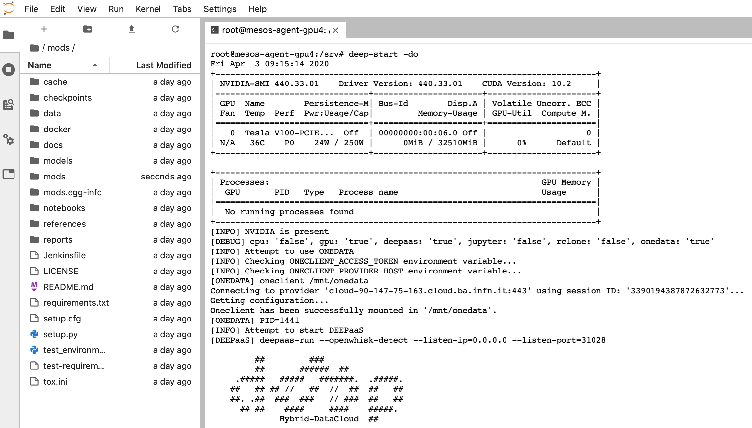
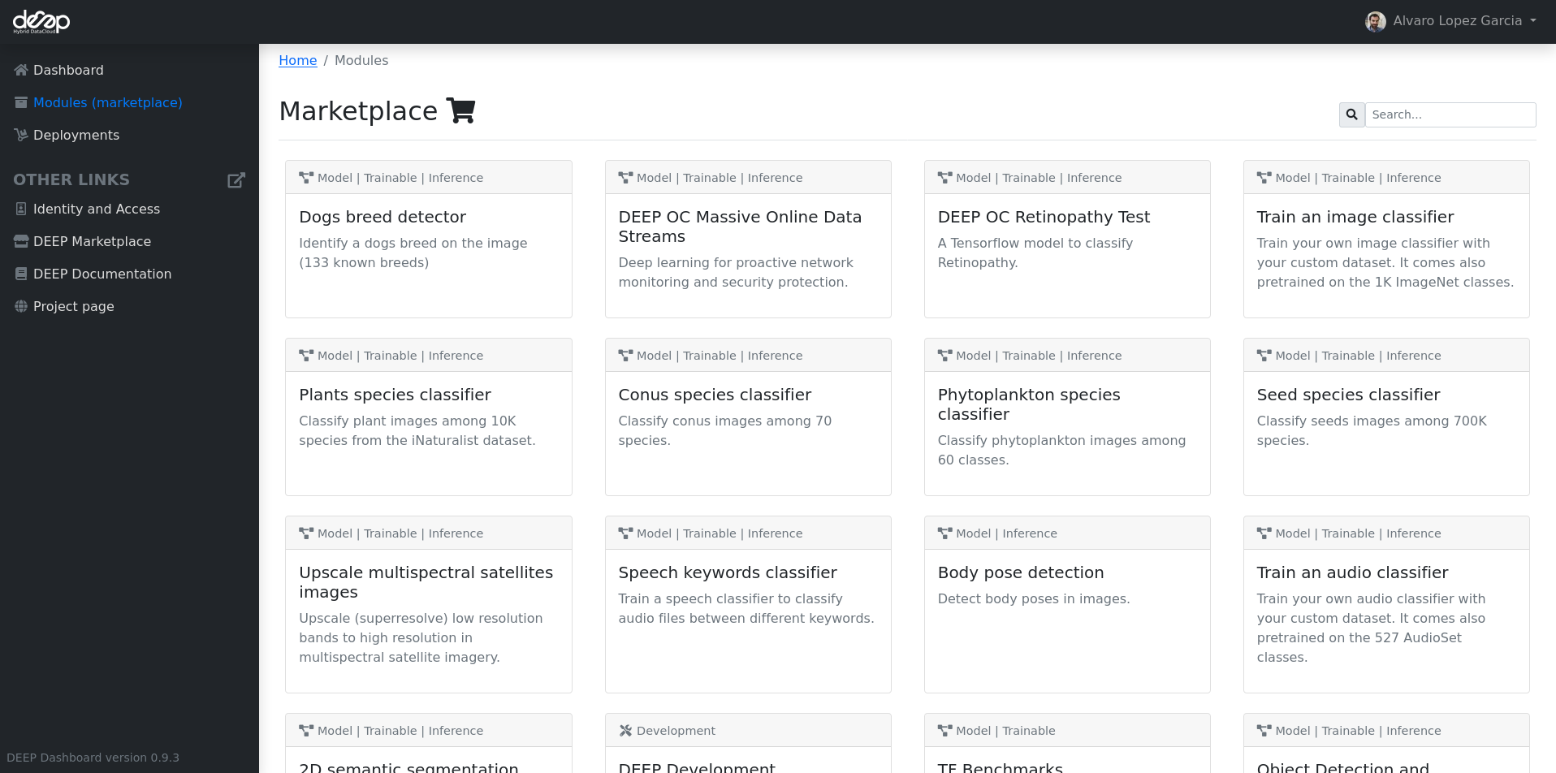
Our technical architecture
5 production AI services
3 AI application prototypes
…for aquatic sciences
12 RIs
(udocker) alvaro:~ $ udocker pull deephdc/deep-oc-obj_detect_pytorch
Info: downloading layer sha256:2746a4a261c9e18bfd7ff0429c18fd7522acc14fa4c7ec8ab37ba5ebaadbc584
(…)
(udocker) alvaro:~ $ udocker create deephdc/deep-oc-obj_detect_pytorch
(udocker) alvaro:~ $ udocker run -p 5000:5000 deephdc/deep-oc-obj_detect_pytorch
Warning: this container exposes TCP/IP ports
Warning: non-existing user will be created
******************************************************************************
* *
* STARTING 9bb8179d-c731-348c-bbf4-e43045ee8936 *
* *
******************************************************************************
executing: deepaas-run
## ###
## ###### ##
.##### ##### #######. .#####.
## ## ## // ## // ## ## ##
##. .## ### ### // ### ## ##
## ## #### #### #####.
Hybrid-DataCloud ##
Welcome to the DEEPaaS API API endpoint. You can directly browse to the
API documentation endpoint to check the API using the builtin Swagger UI
or you can use any of our endpoints.
API documentation: http://0.0.0.0:5000/ui
API specification: http://0.0.0.0:5000/swagger.json
V2 endpoint: http://0.0.0.0:5000/v2
-------------------------------------------------------------------------
Generic, scalable platform for AI/ML applications
EGI federated cloud infrastructure OpenStack GPUs, CPUs, Storage in Spain, Portugal, Turkey, Ireland
1500 TB-months 132,000 GPU-hours 6,000,000 CPU-hours

Slide 12
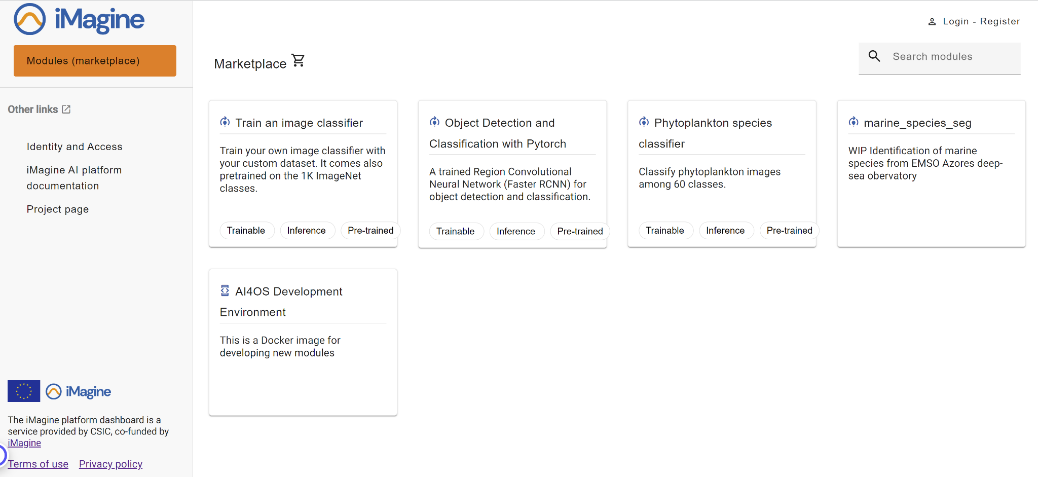
iMagine AI Platform

Slide 13
Common implementation approach
NOW
Continuous interaction with users, feedback & knowledge sharing
Analysis of use cases using Persona-EPIC-User story approach
Gap and Bottleneck analysis
Initial Development roadmaps
Initial collection of requirements for the platform
Update of the roadmaps
Building up operation plans
Summing up lessons learnt for Best practices for
image analysis in aquatic sciences
AI service creation and operation
Development roadmap: https://zenodo.org/record/7760413

Slide 14
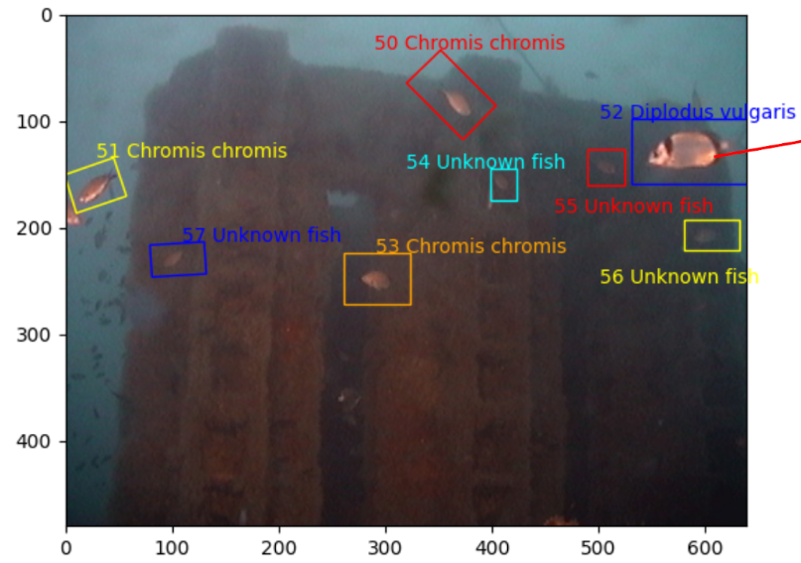
Lessons learnt… so far
Labelling/annotating data: various tools are being assessed and used
Building datasets for training and testing: the real world is noisy!
→ Data quality check is of relevance and interest
Working on metadata to improve FAIRness of data
Selecting AI models for object detection, segmentation, further classification/taxonomy
→ Monitoring of experimentation is helpful
Engineering of end-to-end pipelines
Regular knowledge exchange is important
→ Bi-weekly calls with all the use cases and AI platform experts
Filling manpower gaps is hard…
Labelstud.io
Labelbox.com
Biigle.de

Slide 15
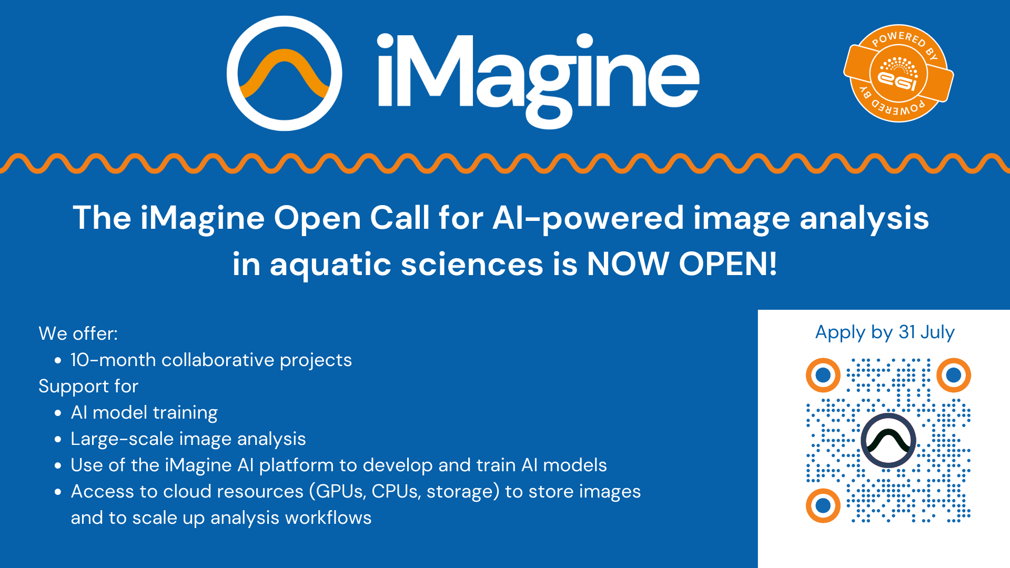
Call for additional use cases

