Slide 1
EU H2020 Project – Grant Agreement number 101058625
Dick M.A. Schaap - (MARIS) iMagine project scientific director
Alvaro Lopez Garcia – (CSIC) iMagine WP4 leader
EGI 2022 Conference – 22 September 2022

Slide 2
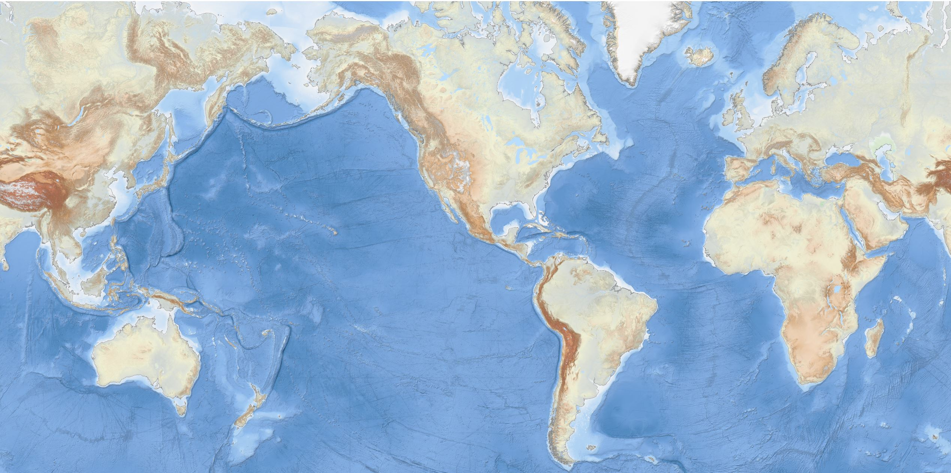
Oceans and seas are important
EMODnet Bathymetry
Climate, Energy, Food, Tourism, Trade, Health, ….

Slide 3
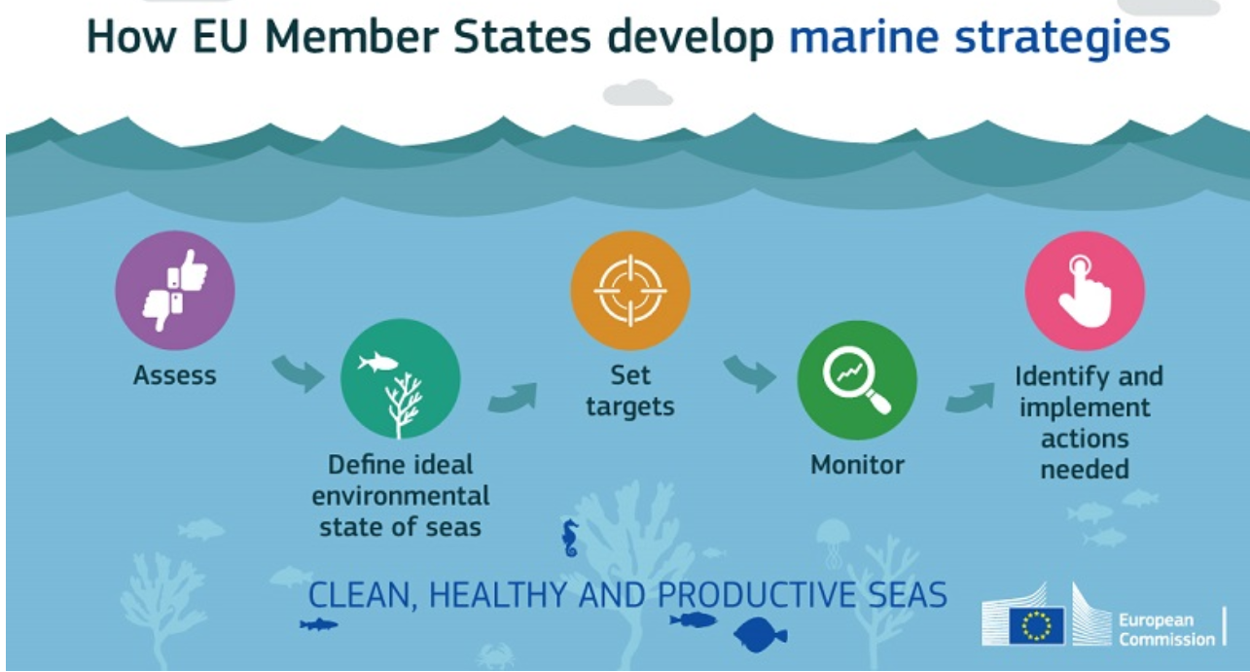
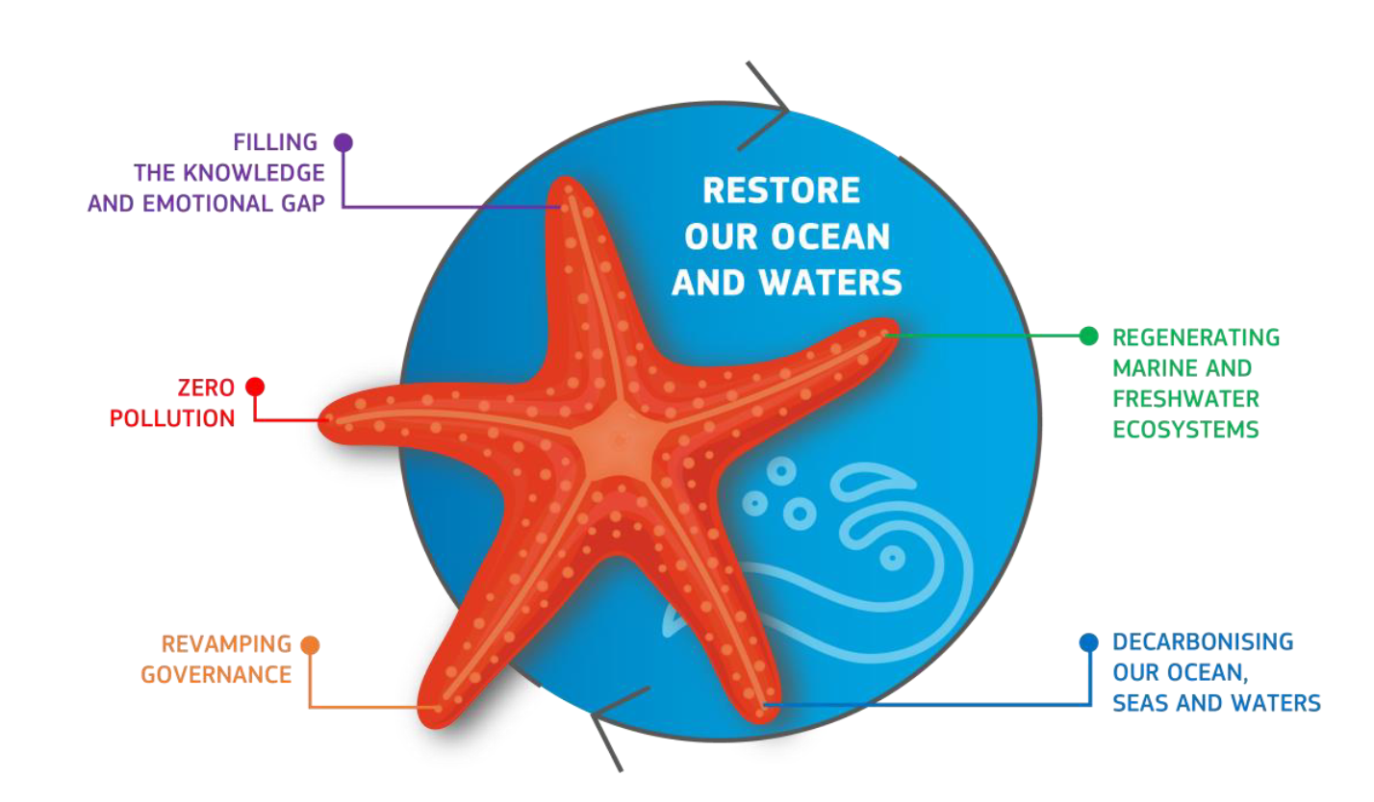
Marine environmental management and policy making
Relevant EU Directives and initiatives for aquatic domain, such as:
Marine Strategy Framework Directive (MSFD)
Water Framework Directive (WFD)
European Green Deal
Mission Starfish 2030 “Healthy oceans, seas, coastal and inland waters”
United Nation’s 2030 Agenda for Sustainable Development
United Nation’s Decade of Ocean Science (2021-2030)
Source: EU MSFD website

Slide 4
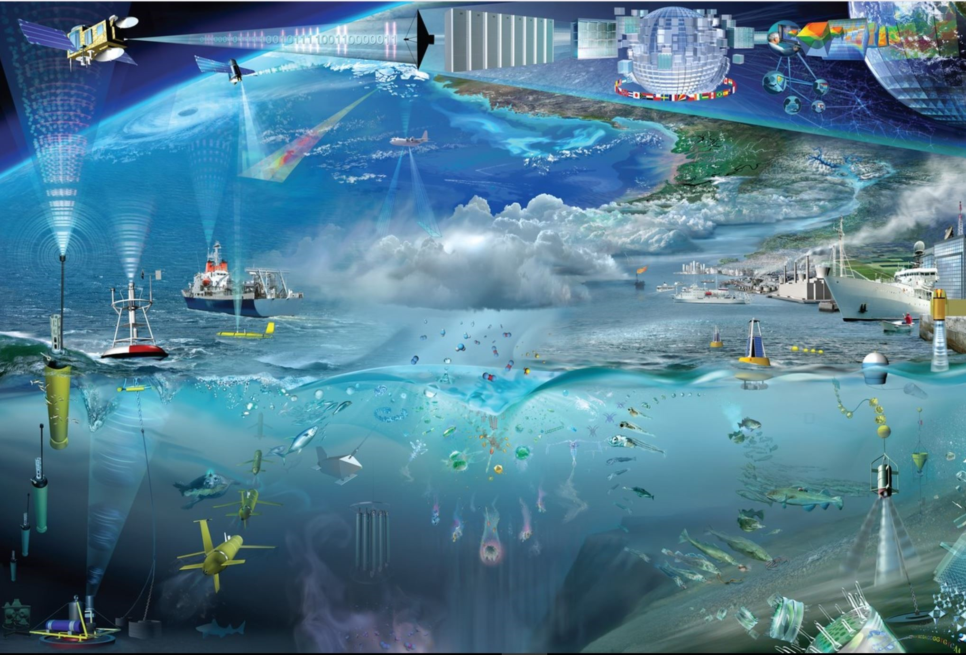
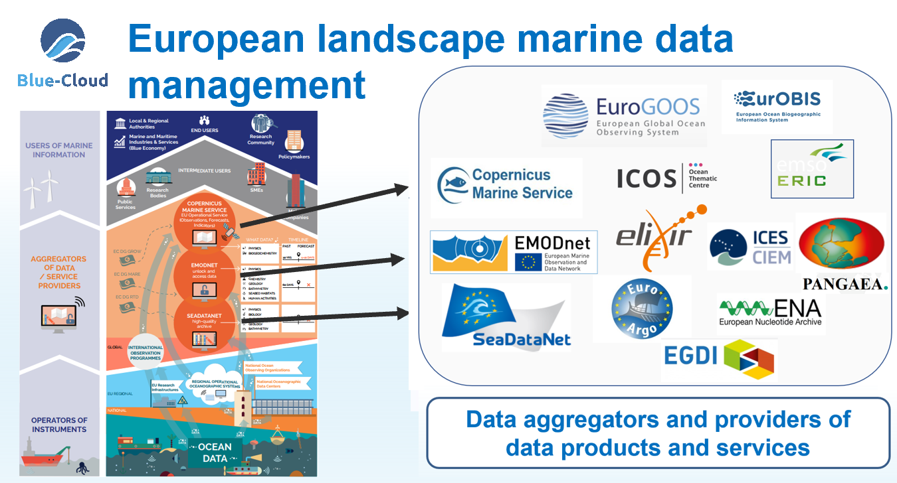
Implementation requires knowledge
The implementation requires an increase of our overall knowledge, demanding more science and improved access to observation data and analytical processing.
Europe already has developed an impressive capability for aquatic environmental observation, data-handling and sharing, modelling and forecasting, second to none in the world. This builds upon national environmental observation and monitoring networks and programs, complemented with EU initiatives such as the Copernicus programme (CMEMS) and EMODnet, and European Research Infrastructures (RIs).
Great additional potential in collecting and processing image data using high-performance image analysis tools, including Artificial Intelligence (AI) techniques, and in more sharing of image repositories.
In Europe we spent circa 1.4 Billion Euro a year in marine data acquisition (1.0 BE in-situ; 0.4 BE remote sensing)

Slide 5
H2020 - iMagine project
Great additional potential in collecting and processing image data using high-performance image analysis tools, including Artificial Intelligence (AI) techniques, and in more sharing of image repositories.
OBJECTIVE:
To deploy, operate, validate, and promote a dedicated iMagine AI framework and platform, connected to EOSC and AI4EU, giving researchers in aquatic sciences open access to a diverse portfolio of AI based image analysis services and image repositories from multiple RIs, working on and of relevance to the overarching theme of ‘Healthy oceans, seas, coastal and inland waters.
From Sept. 2022 until Aug. 2025
€4.5 million EC funding
24 participants
Coordinator – Gergely Sipos (EGI); scientific coordinator – Dick M.A. Schaap (MARIS)

Slide 6
Consortium Overview
Notes:
24 institutes
AI/ML technical experts (5): LIP, CSIC, IISAS, KIT, UPV
Infrastructure providers (6): TUBITAK, CSIC, INCD, Walton, GRNET, EGI
Research services and use cases (13)

Slide 7
Specific Objectives and indicators
O1
Objective 1. Deliver a scalable, shared IT platform for image analysis in marine and freshwater research
Operational iMagine platform with common AI development framework from TRL 7 to 9
O2
Objective 2. Advance existing image analytical services to increase research performance in aquatic sciences
Launch of 5 aquatic AI image services, running operationally at the iMagine platform
O3
Objective 3. Develop & prototype new image analytical services and datasets that can accelerate progress towards healthy oceans, seas, coastal and inland waters
Set of AIS-based imaging processing services of relevance to research for healthy oceans, seas, coastal and inland waters
O4
Objective 4. Capture and disseminate development and operational best practices to imaging data and image analysis service providers
Best Practices documentation, interaction with EOSC and AI4EU platforms.
Training programme
O5
Objective 5. Deliver a portfolio of scientific image and image analytics services targeting researchers in marine and aquatic sciences
Portfolio: operational services, image repositories, Best Practices, iMagine framework and platform

Slide 8
Data repositories overview
Research Infrastructures
LifeWatch
EMBRC
EcoTaxa
JERICO
EMSO-ERIC
Obsea
Antares
DyFaMed
PAP
EuroArgo
EurOBIS
SeaDataNet
EU infrastructures:
Copernicus Marine (CMEMS)
European Marine Observation and Data network (EMODnet)
Notes:
24 institutes
AI/ML technical experts (5): LIP, CSIC, IISAS, KIT, UPV
Infrastructure providers (6): TUBITAK, CSIC, INCD, Walton, GRNET, EGI
Research services and use cases (13)

Slide 9
Overall approach to achieve impact
A common iMagine AI framework and computing platform, based upon earlier DEEP developments and to be built on EGI resources, connected to EOSC, facilitating researchers in development, testing, training, hosting, and operating of AI based image analysis services, following FAIR practices.
Five operational and three prototype AI based image analysis services with image repositories, highly relevant for aquatic sector, to be deployed at the iMagine AI platform for open access and exploitation by researchers. These will demonstrate value and foster further uptake.
Best Practices consisting of documentation and training materials, giving practical guidance and examples to end-users on how to exploit image datasets and analysis applications offered by the iMagine portfolio, and to research engineers who wish to develop and deliver similar services, making use of the facilities of the iMagine AI platform.
Combined with Dissemination, Exploitation & Communication strategy and activities programme, this will maximise impact.

Slide 10
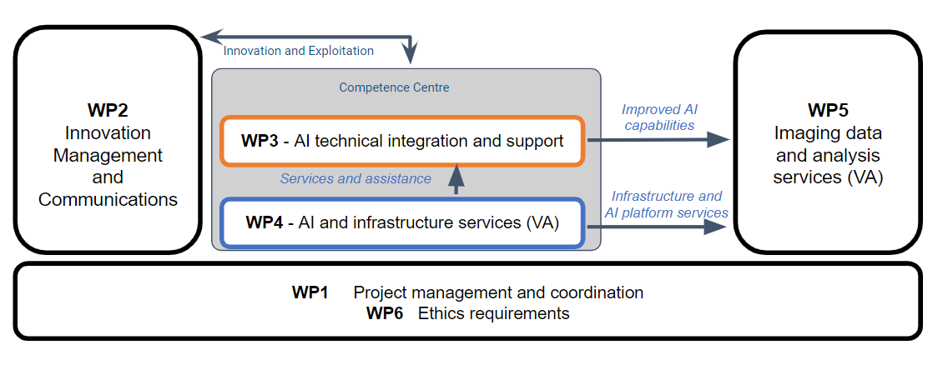
WP structure and coordinators
KIT (Valentin Kozlov)
MARIS (Dick Schaap)
EGI (Smitesh Jain)
CSIC (Álvaro López García)
EGI (Mandy Lin)

Slide 11
Five mature use cases
Aquatic Litter Drones: Aquatic Litter monitoring system using drones | DFKI (DE) + MARIS (NL) + OGS (IT)
EcoTaxa pipeline: Taxonomic identification of zooplankton using Zooscan | Sorbonne Université (LOV+IMEV) (FR)
Ecosystem monitoring at EMSO sites by video imagery | EMSO ERIC (IT) + UPC (ES) + Ifremer (FR) + MI (IE)
Oil Spill Detection: Oil spill detection from satellite images | CMCC (IT) + OrbitalEOS (ES) + University of Trento (IT)
Flowcam phytoplankton identification: Taxonomic identification of phytoplankton using Flowcam images | VLIZ (BE)

Slide 12
Three prototype use cases
Underwater Noise Identification: Underwater noise identification from acoustic recordings using spectrograms | VLIZ (BE)
Beach Monitoring: Posidonia oceanica berms and rip-currents detection from beach monitoring systems | SOCIB (ES)
Freshwater diatoms identification: Identification of freshwater diatoms using microscopic images | UL-LIEC (FR) + CNRS-IRL2958 (FR) + SU-LOCEAN (FR)

Slide 13
DEEP background
https://deep-hybrid-datacloud.eu
DEEP delivered specialized cloud services to develop, exploit and share machine learning, artificial intelligence and deep learning applications → Service-Oriented Architectures and platforms
Covering the whole machine learning application development cycle
Focused on all types of users and user knowledge
Transparent access to specialized computing resources (accelerators, high performance computing) → reduce entry barrier
Build an EOSC machine learning marketplace as an application exchange → ease of use, foster collaboration, knowledge dissemination
Run the same application everywhere (laptop, cloud, HPC, etc.) → ease of use

Slide 14
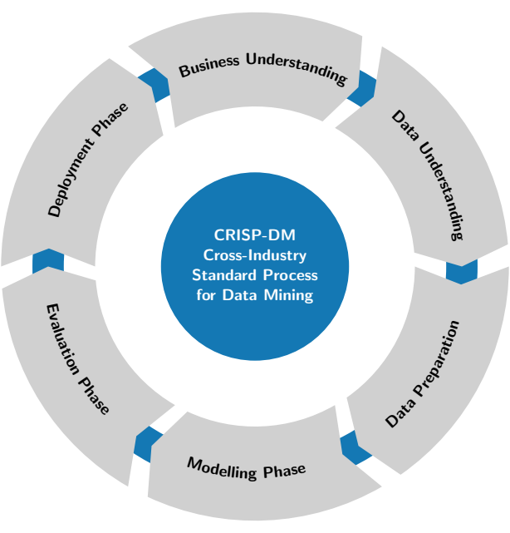
ML/AI development cycle
The DEEP Platform covers all development phases of a machine learning/artificial intelligence application:
Creation, update, improvement of a model (existing or new)
Model training, test, evaluation
Model deployment as a service
Model publication for sharing and reuse

Slide 15
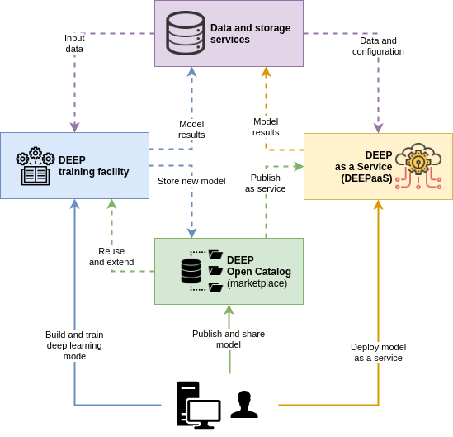
The DEEP services
High level specialized services for exploitation through EOSC, covering the whole model lifecycle:
DEEP Open Catalog → sharing
DEEP training facility → training
DEEP as a Service → deployment
Accesible through the EOSC Portal:
https://marketplace.eosc-portal.eu/services/deepaas-training-facility

Slide 16
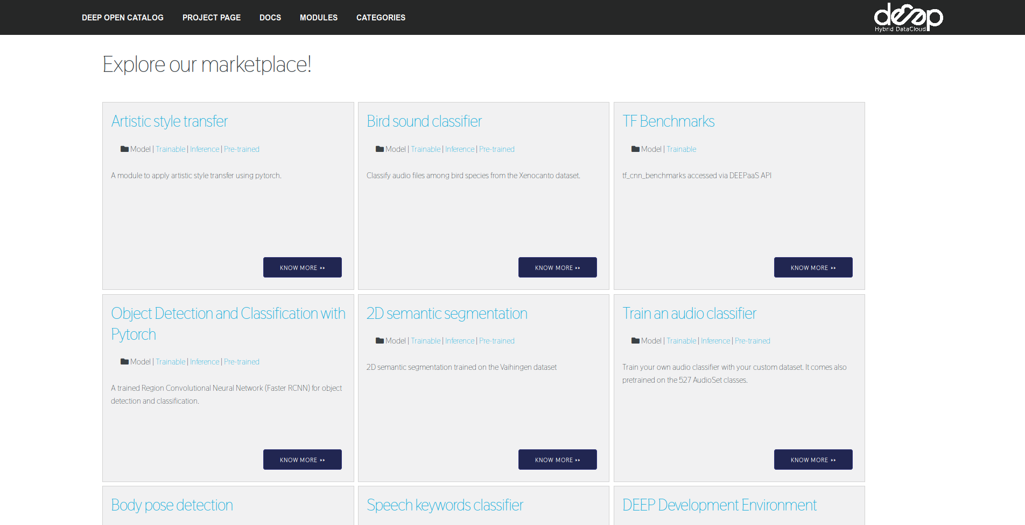
DEEP marketplace

Slide 17
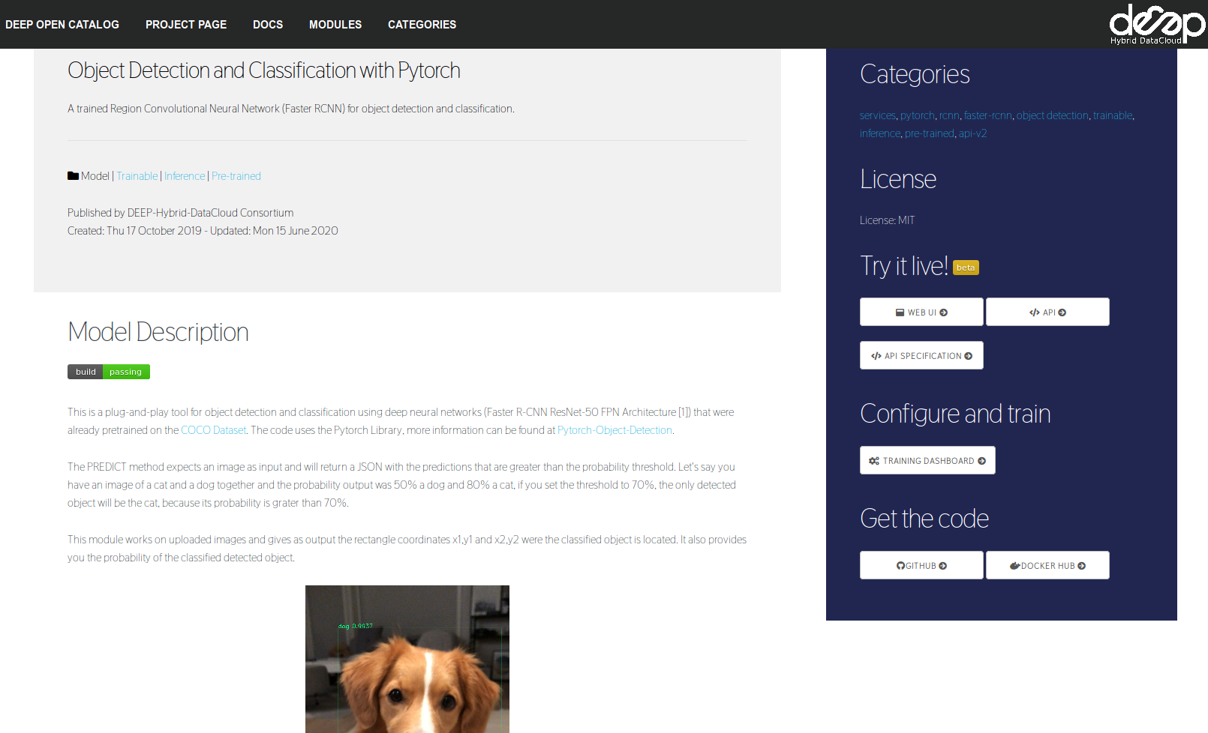
DEEP marketplace entry

Slide 18
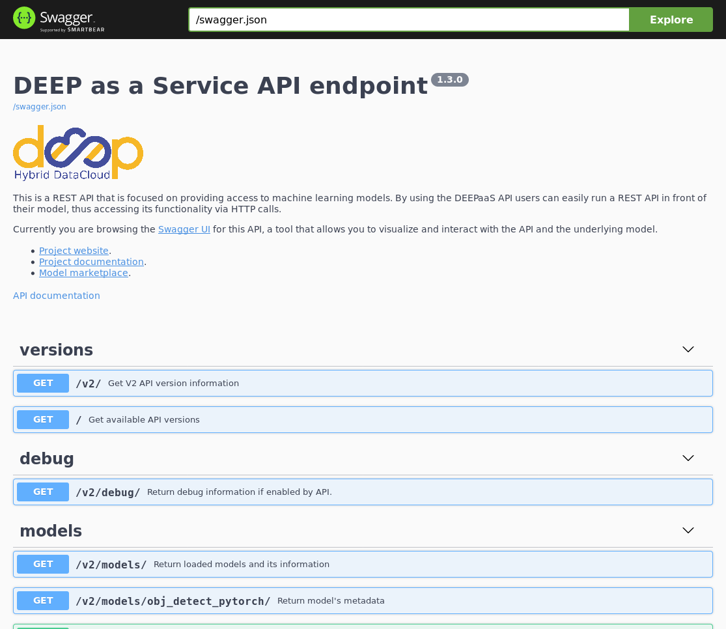
DEEP local inference
(udocker) alvaro:~ $ udocker pull deephdc/deep-oc-obj_detect_pytorch
Info: downloading layer sha256:2746a4a261c9e18bfd7ff0429c18fd7522acc14fa4c7ec8ab37ba5ebaadbc584
(…)
(udocker) alvaro:~ $ udocker create deephdc/deep-oc-obj_detect_pytorch
(udocker) alvaro:~ $ udocker run -p 5000:5000 deephdc/deep-oc-obj_detect_pytorch
Warning: this container exposes TCP/IP ports
Warning: non-existing user will be created
******************************************************************************
* *
* STARTING 9bb8179d-c731-348c-bbf4-e43045ee8936 *
* *
******************************************************************************
executing: deepaas-run
## ###
## ###### ##
.##### ##### #######. .#####.
## ## ## // ## // ## ## ##
##. .## ### ### // ### ## ##
## ## #### #### #####.
Hybrid-DataCloud ##
Welcome to the DEEPaaS API API endpoint. You can directly browse to the
API documentation endpoint to check the API using the builtin Swagger UI
or you can use any of our endpoints.
API documentation: http://0.0.0.0:5000/ui
API specification: http://0.0.0.0:5000/swagger.json
V2 endpoint: http://0.0.0.0:5000/v2
-------------------------------------------------------------------------

Slide 19
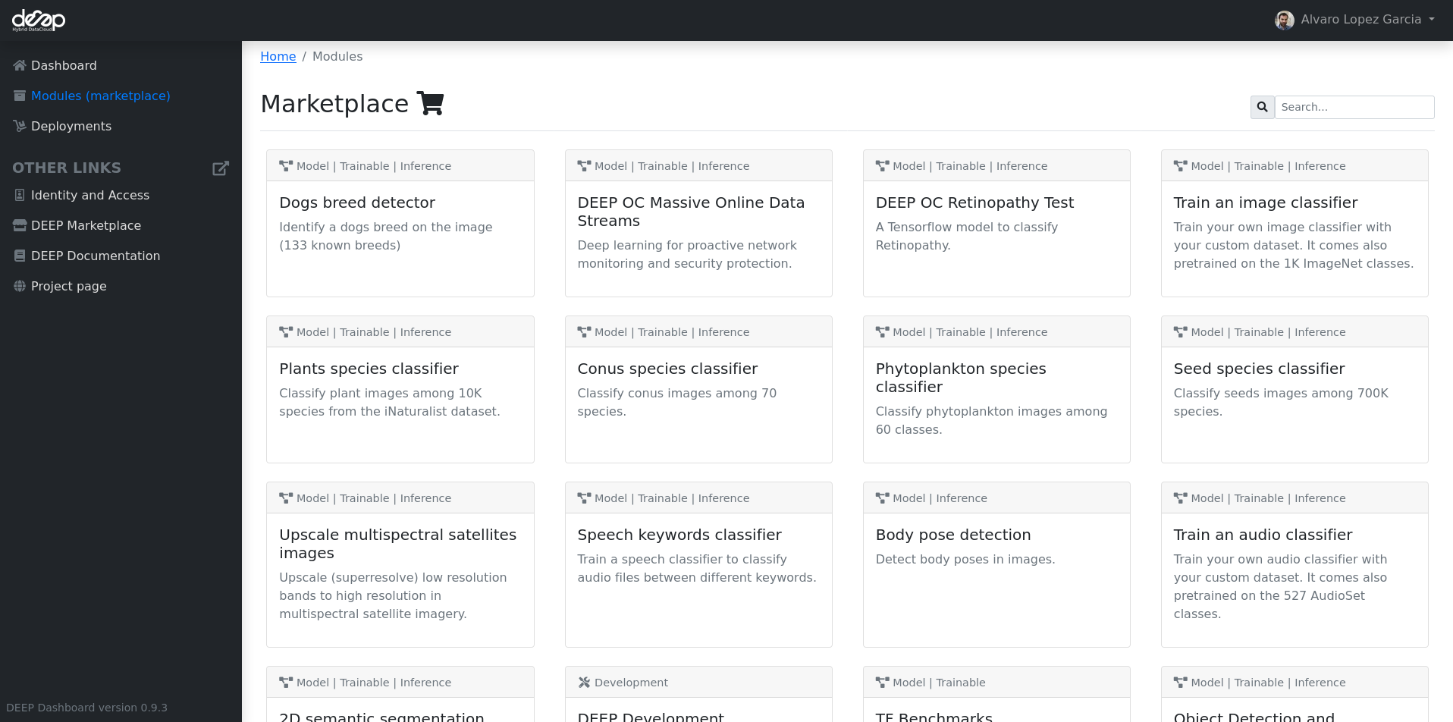
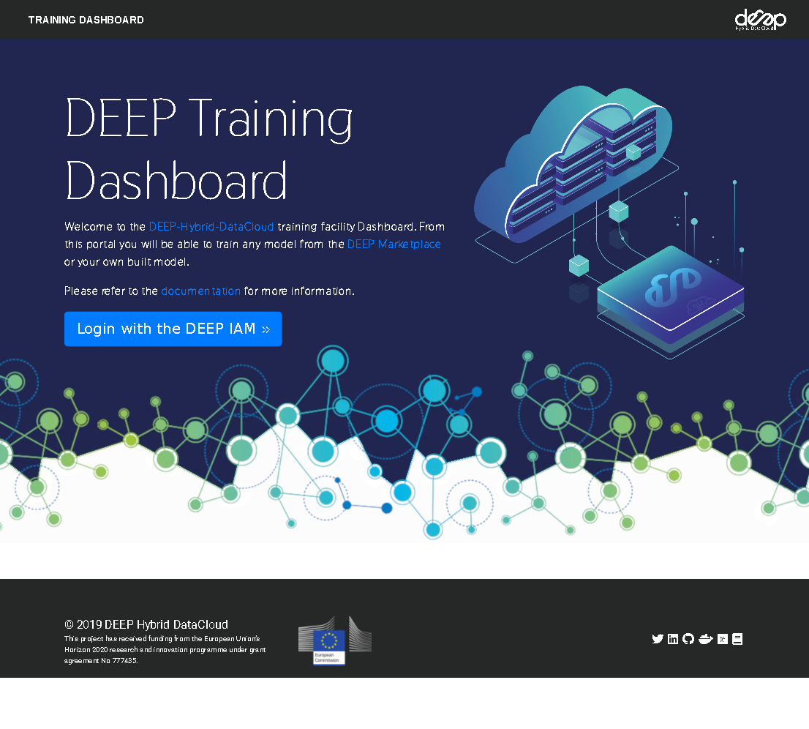
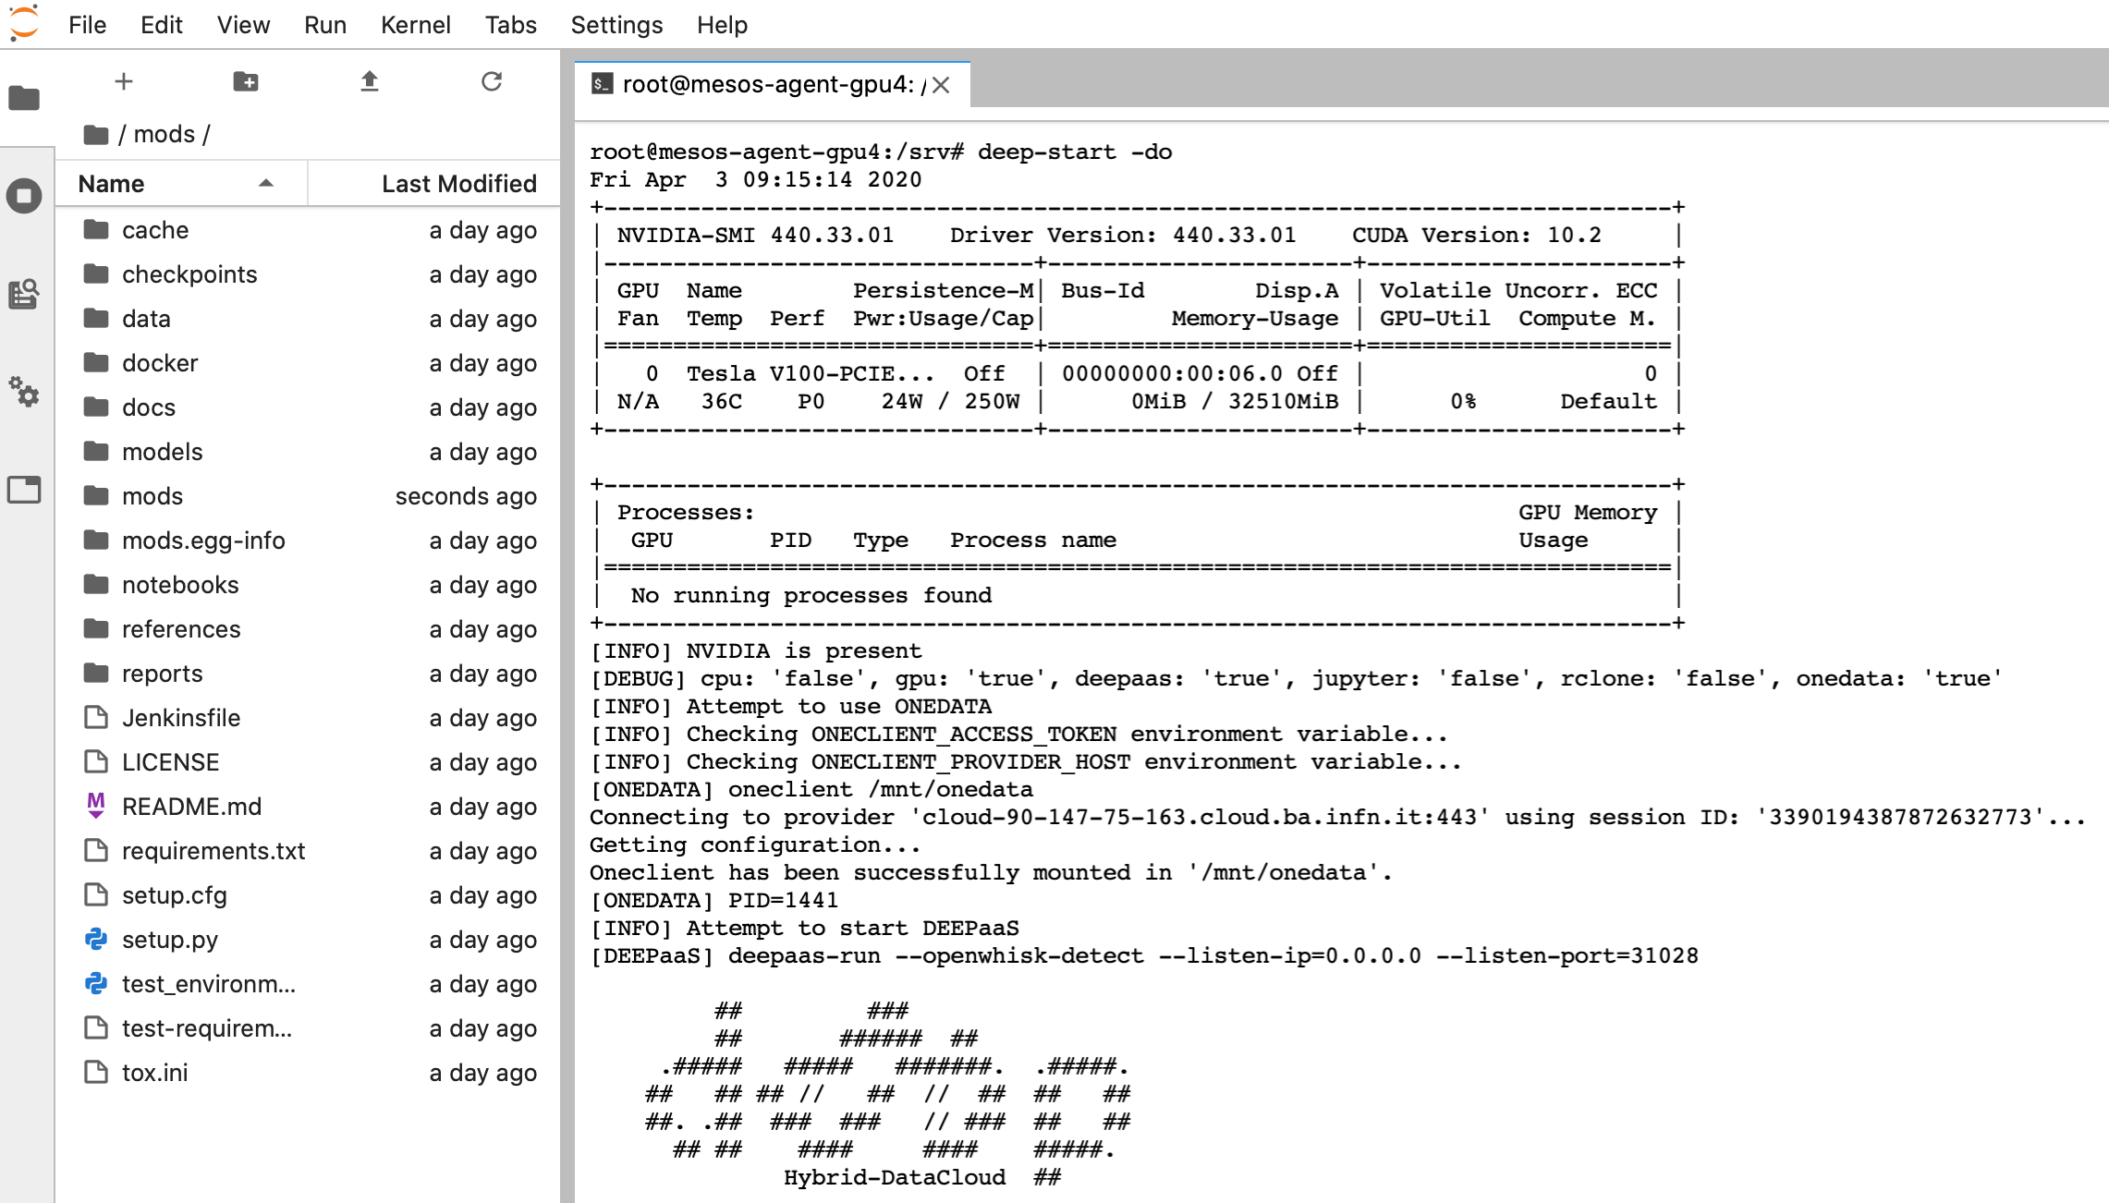
DEEP training and development
1-click development and training environments in Cloud and HPC
https://train.deep-hybrid-datacloud.eu

Slide 20
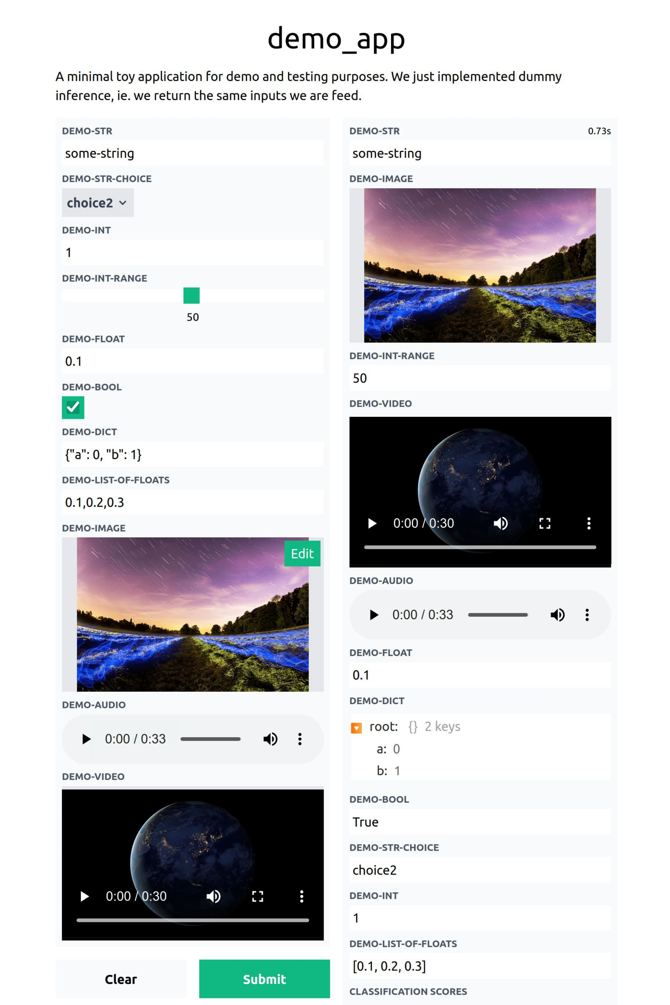
DEEP platform in iMagine
DEEP training platform and marketplace in production at EOSC portal (TRL9)
Imaging use cases to exploit it to develop AI/ML/DL applications
Exploitation of resources from EGI Federated Cloud sites → onboarding of new providers
Transparent access to accelerators
Integration with training and inference APIs
Evolution of DEEPaaS towards on-premises deployments (i.e. self-hosted) and automated deployment of imaging services
Enhancements on DEEPaaS API as required by user communities
E.g. adoption of community standards for inference
Integration with friendly web user interfaces, with special focus on images

Slide 21
Thank you!

